Slide 1

Web Development & Design Foundations with H T M L 5
Ninth Edition
Chapter 3
Configuring Color and Text with C S S
Slides in this presentation contain hyperlinks. JAWS users should be able to get a list of links by using INSERT+F7
Copyright © 2019, 2017, 2015 Pearson Education, Inc. All Rights Reserved
Notes:
If this PowerPoint presentation contains mathematical equations, you may need to check that your computer has the following installed:
1) MathType Plugin
2) Math Player (free versions available)
3) NVDA Reader (free versions available)

Slide 2
Learning Objectives (1 of 2)
3.1 Describe the evolution of style sheets from print media to the Web
3.2 List advantages of using Cascading Style Sheets
3.3 Use color on web pages
3.4 Create style sheets that configure common color and text properties
3.5 Apply inline styles

Slide 3
Learning Objectives (2 of 2)
3.6 Use embedded style sheets
3.7 Use external style sheets
3.8 Configure element, class, id, and contextual selectors
3.9 Utilize the “cascade” in C S S
3.10 Validate C S S

Slide 4
Overview of Cascading Style Sheets (C S S)
See what is possible with C S S:
Visit http://www.csszengarden.com/
Style Sheets
used for years in Desktop Publishing
apply typographical styles and spacing to printed media
C S S
provides the functionality of style sheets (and much more) for web developers
a flexible, cross-platform, standards-based language developed by the W3C.

Slide 5
C S S Advantages
Greater typography and page layout control
Style is separate from structure
Styles can be stored in a separate document and associated with the web page
Potentially smaller documents
Easier site maintenance

Slide 6
Types of Cascading Style Sheets
Inline Styles
Embedded Styles
External Styles
Imported Styles

Slide 7
Cascading Style Sheets (1 of 2)
Inline Styles
body section
H T M L style attribute
apply only to the specific element
Embedded Styles
head section
H T M L style element
apply to the entire web page document

Slide 8
Cascading Style Sheets (2 of 2)
External Styles
Separate text file with .c s s file extension
Associate with a H T M L link element in the head section of a web page
Imported Styles
Similar to External Styles
We’ll concentrate on the other three types of styles.

Slide 9
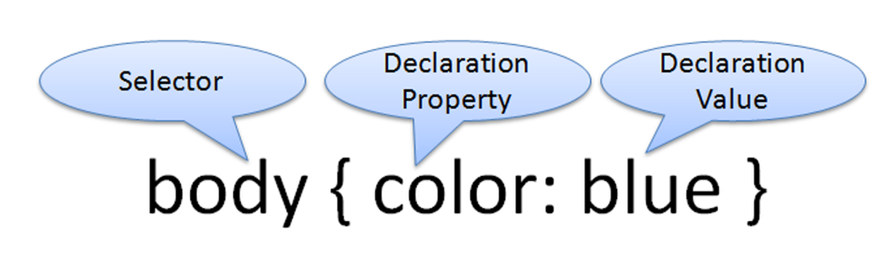
C S S Syntax
Style sheets are composed of “Style Rules” that describe the styling to be applied.
Each Rule contains a Selector and a Declaration
The selector can be an HTML element name, a class name, or an id name.
The declaration indicates the CSS property and the value

Slide 10
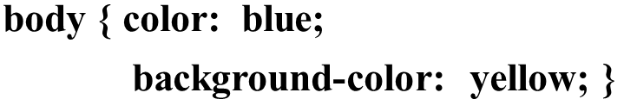
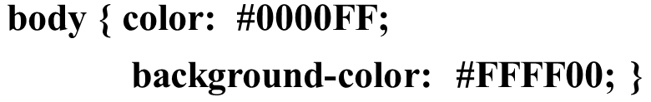
C S S Syntax Sample
Configure a text color of a web page to be blue and background color to be yellow.
This could also be written using hexadecimal color values as shown below.
Notes:
To configure more than one property for a selector, use a semicolon to separate the declarations.

Slide 11
Common Formatting C S S Properties
See Table 3.1 (see slide 12,13,14 and 15)Common C S S Properties, including:
background-color
color
font-family
font-size
font-style
font-weight
line-height
margin
text-align
text-decoration
width

Slide 12
Table 3.1 C S S Properties (1 of 4)
Property | Description | Values
background-color | Background color of an element | Any valid color
color | Foreground (text) color of an element | Any valid color
font-family | Name of a font or font family | Any valid font or a font family such as serif, sansserif, fantasy, monospace, or cursive
font-size | Size of the font | Varies; a numeric value with pt (standard font point sizes) or px (pixels) units or the unit em (which corresponds to the width of the uppercase M of the current font); a numeric percentage; and the text values xx-small, x-small, small, medium, large, x-large, and xx-large
font-style | Style of the font | normal, italic, or oblique

Slide 13
Table 3.1 C S S Properties (2 of 4)
Property | Description | Values
font-weight | The “boldness” or weight of the font | Varies; the text values normal, bold, bolder, and lighter and the numeric values 100, 200, 300, 400, 500, 600, 700, 800, and 900
letter-spacing | The space between characters | A numeric value (px or em) or normal (default)
line-height | The spacing allowed for the line of text | It is most common to use a percentage for this value; for example, a value of 200% would correspond to double-spacing.
margin | Shorthand notation to configure the margin surrounding an element | A numeric value (px or em); for example, body {margin: 10px} will set the page margins in the document to 10 pixels. When eliminating the margin, do not use the px or em unit—for example, body {margin:0}

Slide 14
Table 3.1 C S S Properties (3 of 4)
Property | Description | Values
margin-left | Configures the space in the left margin of the element | A numeric value (px or em), auto, or 0
margin-right | Configures the space in the right margin of the element | A numeric value (px or em), auto, or 0
text-align | The alignment of text | center, justify, left, or right
text-decoration | Determines whether text is underlined; this style is most often applied to hyperlinks | The value “none” will cause a hyperlink not to be underlined in a browser that normally processes in this manner
text-indent | Configures the indentation of the first line of text | Numeric value (px or em) or percentage

Slide 15
Table 3.1 C S S Properties (4 of 4)
Property | Description | Values
text-shadow | Configures a drop shadow on the text displayed within an element. This C S S3 property is not supported in all browsers. | Two to four numerical values (px or em) to indicate horizontal offset, vertical offset, blur radius (optional), and spread distance (optional), and a valid color value.
text-transform | Configures the capitalization of text | none (default), capitalize, uppercase, or lowercase
white-space | Configures the display of whitespace | normal (default), nowrap, pre, pre-line, pre-wrap
width | The width of the content of an element | A numeric value (px or em), numeric percentage, or auto (default)
word-spacing | The space between words | A numeric value (px or em) or normal (default)

Slide 16
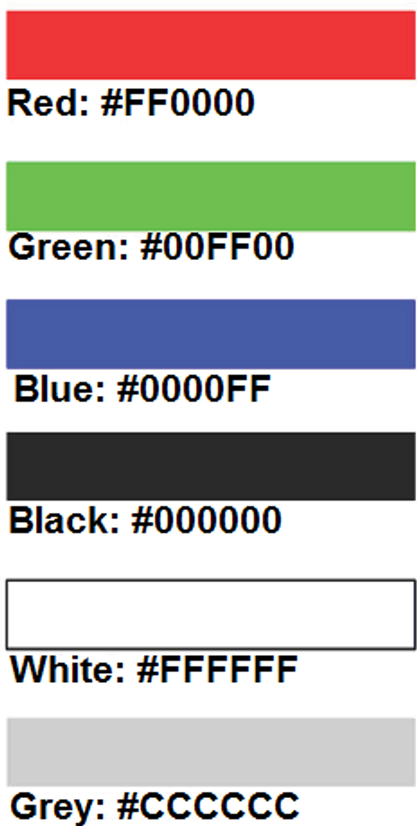
Using Color on Web Pages
Computer monitors display color as intensities of red, green, and blue light
R G B Color
The values of red, green, and blue vary from 0 to 255.
We use hexadecimal color values to specify RGB color on web pages.
Hexadecimal numbers (base 16) represent these color values.

Slide 17
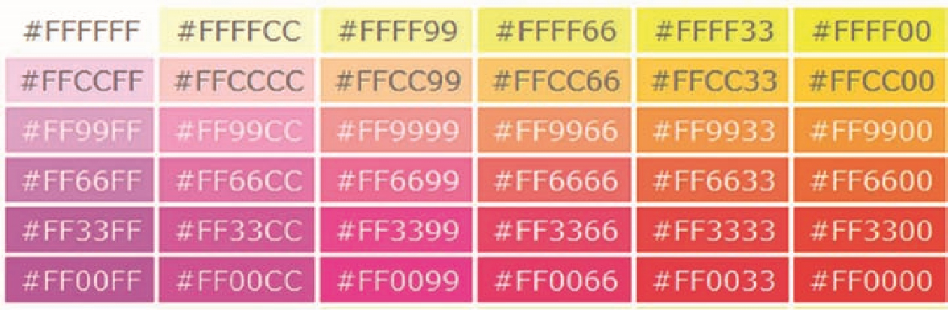

Hexadecimal Color Values
# indicates a hexadecimal value
Hex value pairs range from 00 to F F
Three hex value pairs describe an R G B color

Slide 18
Web-Safe Color Palette
A collection of 216 colors
Display the most similar on the Mac and P C platforms
Hex values of web safe colors: 00, 33, 66, 99, C C, FF
Color Chart http://webdevfoundations.net/color

Slide 19
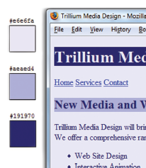
Making Color Choices
How to choose a color scheme?
Monochromatic
http://meyerweb.com/eric/tools/color-blend
Choose from a photograph or other image
http://www.colr.org
Begin with a favorite color
Use one of the sites below to choose other colors
http://colorsontheweb.com/colorwizard.asp
https://color.adobe.com/create/color-wheel
http://paletton.com

Slide 20
Support Web Accessiblity Verify Sufficient Contrast
When you choose colors for text and background, sufficient contrast is needed so that the text is easy to read.
Use one of the following online tools to verify contrast:
http://webaim.org/resources/contrastchecker
http://snook.ca/technical/colour_contrast/colour.html
http://juicystudio.com/services/luminositycontrastratio.php

Slide 21

Configuring Color with Inline C S S (1 of 2)
Inline C S S
Configured in the body of the web page
Use the style attribute of an H T M L tag
Apply only to the specific element
The Style Attribute
Value: one or more style declaration property and value pairs
Example: configure red color text in an

Slide 22
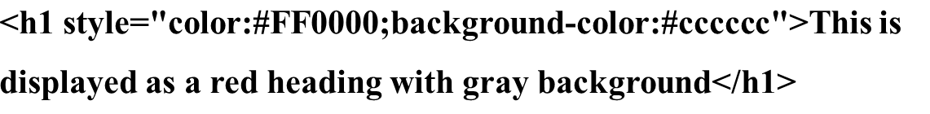
Configuring Color with Inline C S S (2 of 2)
Example 2: configure the red text in the heading configure a gray background in the heading
Separate style rule declarations with;

Slide 23
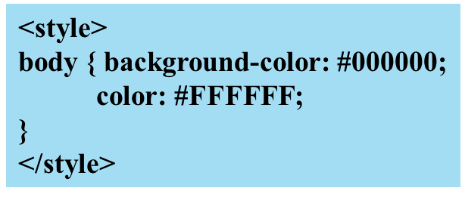

C S S Embedded (Internal) Styles
Configured in the head section of a web page.
Use the H T M L
Apply to the entire web page document
Style declarations are contained between the opening and closing
Example: Configure a web page with white text on a black background

Slide 24
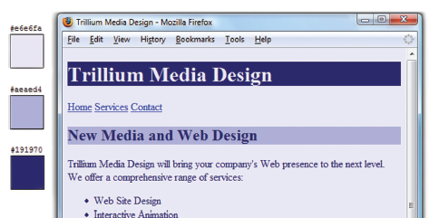
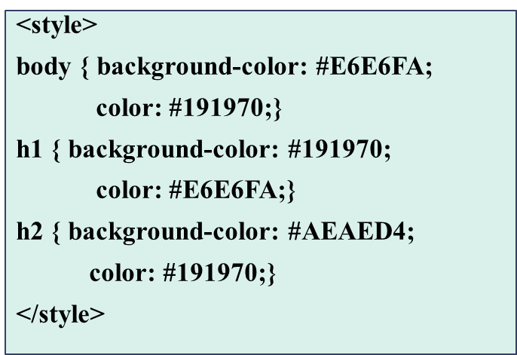
C S S Embedded Styles
The body selector sets the global style rules for the entire page.
These global rules are overridden for
elements by the h1 and h2 style rules.

Slide 25
Checkpoint 3.1
List three reasons to use C S S on a web page.
When designing a page that uses colors other than the default colors for text and background, explain why it is a good reason to configure style rules for both text color and background color.
Describe one advantage to using embedded styles instead of inline styles.

Slide 26
Configuring Text with C S S
C S S properties for configuring text:
font-weight
Configures the boldness of text
font-style
Configures text to an italic style
font-size
Configures the size of the text
font-family
Configures the font typeface of the text

Slide 27
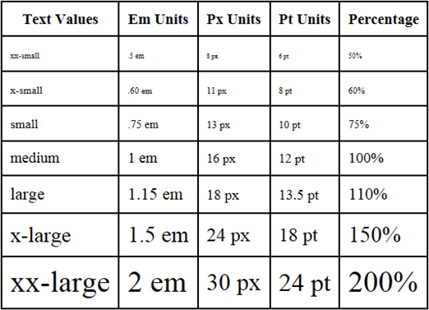
The Font-Size Property
Accessibility Recommendation: Use em or percentage font sizes – these can be easily enlarged in all browsers by users

Slide 28

The Font-Family Property
Font Family Category | Font Typeface
serif | Times New Roman, Georgia, Times
sans-Serif | Arial, Verdana, Geneva
monospace | Courier new, Lucida Console
cursive | Brush Script M7 , Comic sans MS
fantasy | Jokeman, Curlz MT
Not everyone has the same fonts installed in their computer Configure a list of fonts and include a generic family name

Slide 29

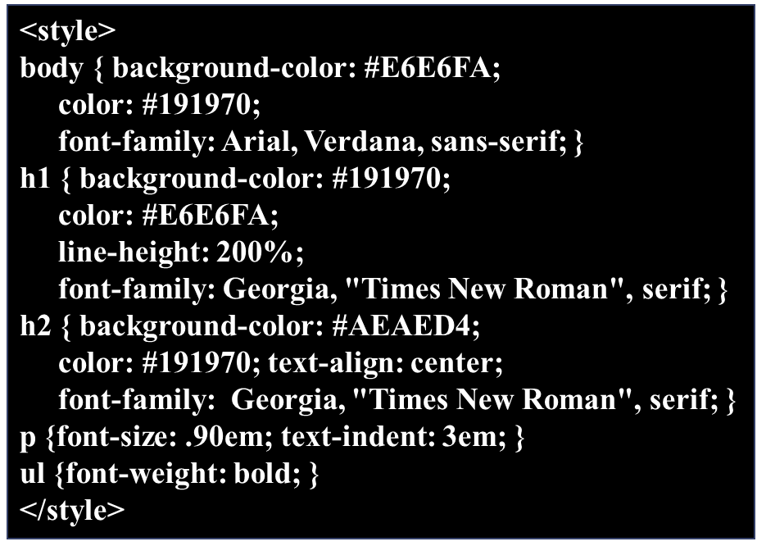
Embedded Styles Example

Slide 30
More C S S Text Properties (1 of 2)
line-height
Configures the height of the line of text (use the value 200% to appear double-spaced)
text-align
Configures alignment of text within a block display element
text-indent
Configures the indentation of the first line of text
text-decoration
Modifies the appearance of text with an underline, overline, or line-through

Slide 31
More C S S Text Properties (2 of 2)
text-transform
Configures the capitalization of text
letter-spacing
Configures space between text characters
word-spacing
Configures space between words
text-shadow
Configures a drop shadow on text

Slide 32
C S S Selectors
C S S style rules can be configured for an:
H T M L element selector
class selector
id selector
descendant selector

Slide 33
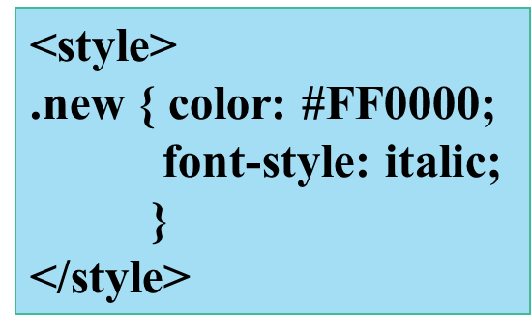
Using C S S with “Class”
class Selector
Apply a C S S rule to a certain “class” of elements on a web page
Does not associate the style to a specific H T M L element
Configure with .classname
code C S S to create a class called “new” with red italic text.
Apply the class:

Slide 34
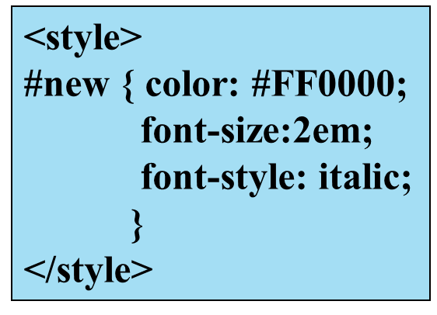

Using C S S with “Id”
id Selector
Apply a C S S rule to One element on a web page.
Configure with #idname
Code C S S to create an id called “new” with red, large, italic text.
Apply the id:

Slide 35
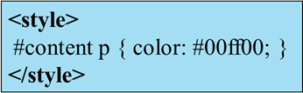
C S S Descendant Selector
Specify an element within the context of its container (parent) element.
A K A contextual selector
The example configures a green text color only for p tags located within an element assigned to the id named content
Advantage of contextual selectors: Reduces the number of classes and ids you need to apply in the H T M L

Slide 36
Span Element
Purpose:
configure a specially formatted area displayed in-line with other elements, such as within a paragraph.
There is no additional empty space above or below a span – it is inline display.

Slide 37
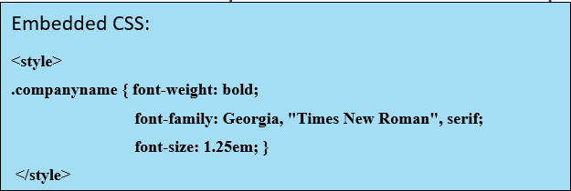

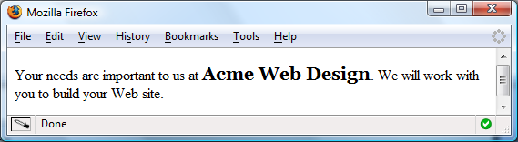
Span Element Example
H T M L:

Slide 38
External Style Sheets (1 of 2)
C S S style rules are contained in a text file separate from the H T M L documents.
The External Style Sheet text file:
extension ".c s s"
contains only style rules
does not contain any H T M L tags

Slide 39
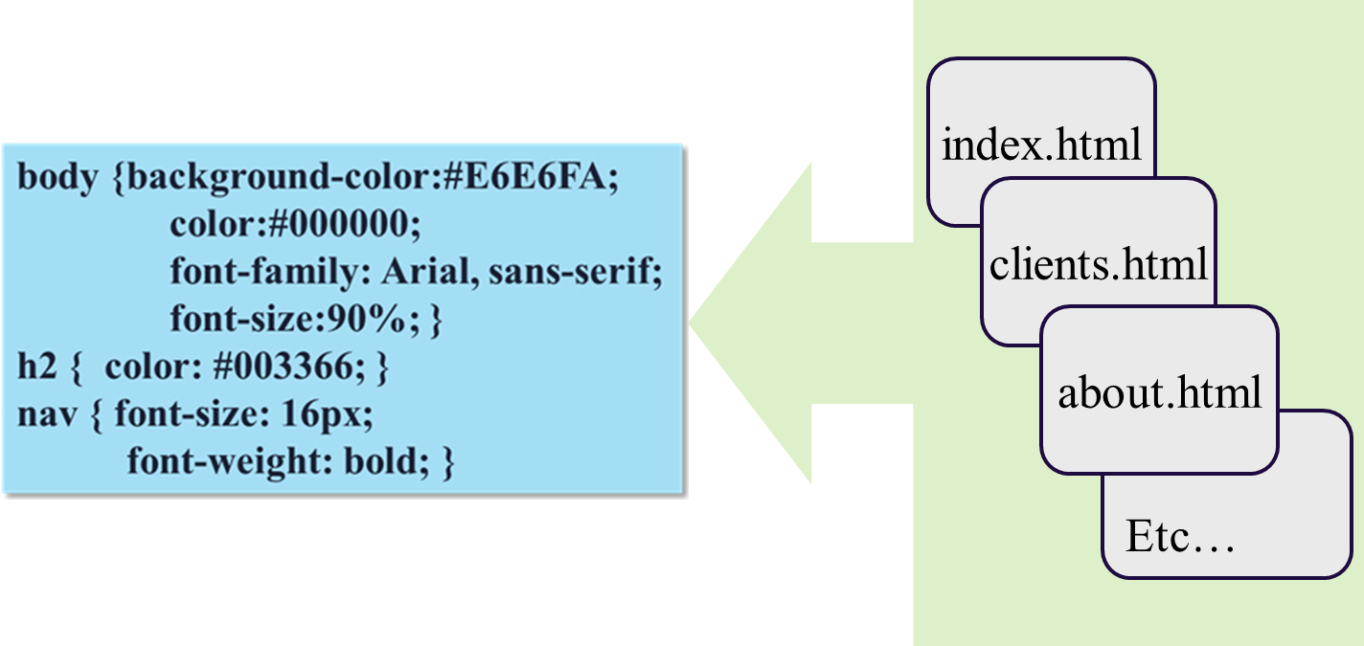
External Style Sheets (2 of 2)
Multiple web pages can associate with the same external style sheet file.
site.css

Slide 40

Link Element
A self-contained tag
Placed in the head section
Purpose: associates the external style sheet file with the web page.
Example:

Slide 41


Using an External Style Sheet
External Style Sheet color.c s s
To associate the external style sheet called color.css, the H T M L code placed in the head section is:

Slide 42
Checkpoint 3.2
Describe a reason to use embedded styles. Explain where embedded styles are placed on a web page.
Describe a reason to use external styles. Explain where external styles are placed and how web pages indicate they are using external styles.
Write the code to configure a web page to use an external style sheet called “mystyles.c s s”.

Slide 43
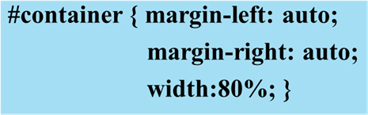

Centering Page Content with C S S

Slide 44
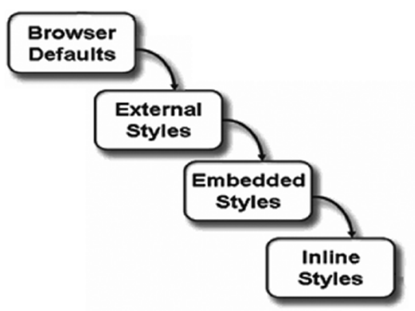
The “Cascade”

Slide 45
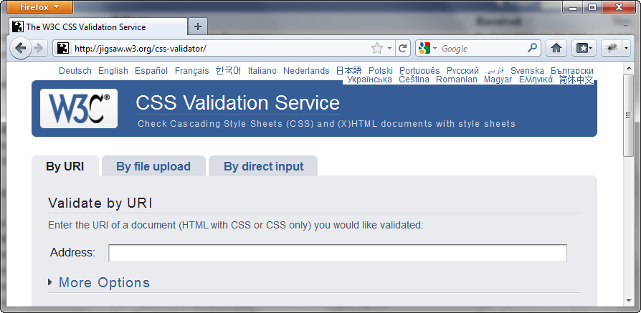
W3C C S S Validation
http://jigsaw.w3.org/css-validator/

Slide 46
Summary
This chapter introduced you to Cascading Style Sheet Rules associated with color and text on web pages.
You configured inline styles, embedded styles, and external styles.
You applied C S S style rues to H T M L, class, id, and descendent selectors.
You are able to submit your C S S to the W3C C S S Validation test.

Slide 47

Copyright

